Slide 1
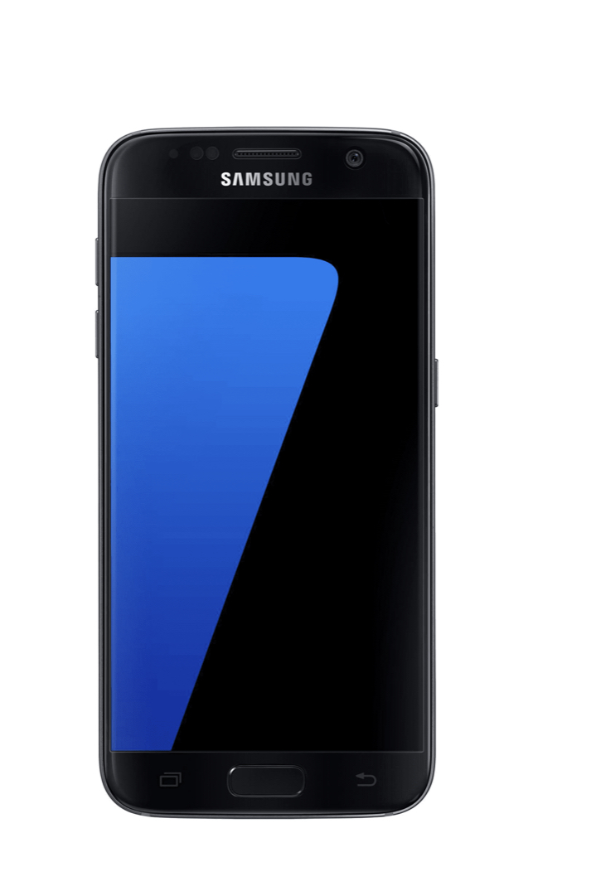
SCREENTIME
What is the truth around screentime usage amongst Year 11’s in the UK?
In todays lesson we are going to look at this.

Slide 2
Screen time usage: James Hornsby
James Hornsby
Screen time per day (mins) | Frequency | Upper Limit | Cumulative Frequency
0-60 | 1 | <60
61-120 | 3 | <120
121-180 | 0 | <180
181-240 | 9 | <240
241-300 | 2 | <300
301-360 | 3 | <360
361-420 | 3 | <420
421-480 | 2 | <480
481-540 | 1 | <540
541-600 | 1 | <600
We are going to use a cumulative frequency graph to show screen time usage.

Slide 3
James Hornsby
Screen time per day (mins) | Frequency | Upper Limit | Cumulative Frequency
0-60 | 1 | <60 | 1
61-120 | 3 | <120
121-180 | 0 | <180
181-240 | 9 | <240
241-300 | 2 | <300
301-360 | 3 | <360
361-420 | 3 | <420
421-480 | 2 | <480
481-540 | 1 | <540
541-600 | 1 | <600
We are going to use a cumulative frequency graph to show the screen time usage.
Cumulative Frequency is when we keep a running total.

Slide 4
James Hornsby
Screen time per day (mins) | Frequency | Upper Limit | Cumulative Frequency
0-60 | 1 | <60 | 1
61-120 | 3 | <120 | 4
121-180 | 0 | <180
181-240 | 9 | <240
241-300 | 2 | <300
301-360 | 3 | <360
361-420 | 3 | <420
421-480 | 2 | <480
481-540 | 1 | <540
541-600 | 1 | <600
We are going to use a cumulative frequency graph to show screen time usage.
Cumulative Frequency is when we keep a running total.
The value in this column is 4. This value is obtained by adding all of the values that are less than <120. In this case 3 and 1.

Slide 5
James Hornsby
Screen time per day (mins) | Frequency | Upper Limit | Cumulative Frequency
0-60 | 1 | <60 | 1
61-120 | 3 | <120 | 4
121-180 | 0 | <180 | 4
181-240 | 9 | <240 | 13
241-300 | 2 | <300
301-360 | 3 | <360
361-420 | 3 | <420
421-480 | 2 | <480
481-540 | 1 | <540
541-600 | 1 | <600
We are going to use a cumulative frequency graph to show screen time usage.
Cumulative Frequency is when we keep a running total.
The value in this column is 13. This value is obtained by adding all of the values that are less than <240. In this case 9, 0, 3 and 1.

Slide 6
James Hornsby
Screen time per day (mins) | Frequency | Upper Limit | Cumulative Frequency
0-60 | 1 | <60 | 1
61-120 | 3 | <120 | 4
121-180 | 0 | <180 | 4
181-240 | 9 | <240 | 13
241-300 | 2 | <300 | 15
301-360 | 3 | <360
361-420 | 3 | <420
421-480 | 2 | <480
481-540 | 1 | <540
541-600 | 1 | <600
We are going to use a cumulative frequency graph to show screen time usage.
Cumulative Frequency is when we keep a running total.
This process is repeated until the table is completed.

Slide 7
James Hornsby
Screen time per day (mins) | Frequency | Upper Limit | Cumulative Frequency
0-60 | 1 | <60 | 1
61-120 | 3 | <120 | 4
121-180 | 0 | <180 | 4
181-240 | 9 | <240 | 13
241-300 | 2 | <300 | 15
301-360 | 3 | <360 | 18
361-420 | 3 | <420
421-480 | 2 | <480
481-540 | 1 | <540
541-600 | 1 | <600
We are going to use a cumulative frequency graph to show screen time usage.
Cumulative Frequency is when we keep a running total.
This process is repeated until the table is completed.

Slide 8
James Hornsby
Screen time per day (mins) | Frequency | Upper Limit | Cumulative Frequency
0-60 | 1 | <60 | 1
61-120 | 3 | <120 | 4
121-180 | 0 | <180 | 4
181-240 | 9 | <240 | 13
241-300 | 2 | <300 | 15
301-360 | 3 | <360 | 18
361-420 | 3 | <420 | 21
421-480 | 2 | <480
481-540 | 1 | <540
541-600 | 1 | <600
We are going to use a cumulative frequency graph to show screen time usage.
Cumulative Frequency is when we keep a running total.
This process is repeated until the table is completed.

Slide 9
James Hornsby
Screen time per day (mins) | Frequency | Upper Limit | Cumulative Frequency
0-60 | 1 | <60 | 1
61-120 | 3 | <120 | 4
121-180 | 0 | <180 | 4
181-240 | 9 | <240 | 13
241-300 | 2 | <300 | 15
301-360 | 3 | <360 | 18
361-420 | 3 | <420 | 21
421-480 | 2 | <480 | 23
481-540 | 1 | <540
541-600 | 1 | <600
We are going to use a cumulative frequency graph to show screen time usage.
Cumulative Frequency is when we keep a running total.
This process is repeated until the table is completed.

Slide 10
James Hornsby
Screen time per day (mins) | Frequency | Upper Limit | Cumulative Frequency
0-60 | 1 | <60 | 1
61-120 | 3 | <120 | 4
121-180 | 0 | <180 | 4
181-240 | 9 | <240 | 13
241-300 | 2 | <300 | 15
301-360 | 3 | <360 | 18
361-420 | 3 | <420 | 21
421-480 | 2 | <480 | 23
481-540 | 1 | <540 | 24
541-600 | 1 | <600
We are going to use a cumulative frequency graph to show screen time usage.
Cumulative Frequency is when we keep a running total.
This process is repeated until the table is completed.

Slide 11
James Hornsby
Screen time per day (mins) | Frequency | Upper Limit | Cumulative Frequency
0-60 | 1 | <60 | 1
61-120 | 3 | <120 | 4
121-180 | 0 | <180 | 4
181-240 | 9 | <240 | 13
241-300 | 2 | <300 | 15
301-360 | 3 | <360 | 18
361-420 | 3 | <420 | 21
421-480 | 2 | <480 | 23
481-540 | 1 | <540 | 24
541-600 | 1 | <600 | 25
We are going to use a cumulative frequency graph to show screen time usage.
Cumulative Frequency is when we keep a running total.
This process is repeated until the table is completed.

Slide 12
James Hornsby
Screen time per day (mins) | Frequency | Upper Limit | Cumulative Frequency
0-60 | 1 | <60 | 1
61-120 | 3 | <120 | 4
121-180 | 0 | <180 | 4
181-240 | 9 | <240 | 13
241-300 | 2 | <300 | 15
301-360 | 3 | <360 | 18
361-420 | 3 | <420 | 21
421-480 | 2 | <480 | 23
481-540 | 1 | <540 | 24
541-600 | 1 | <600 | 25
Once you have completed the table you put the information into a cumulative frequency curve. The reason we do this is so that we can look at some key data like the median and quartiles.
28
24
Cumulative Frequency
20
16
12
8
4
0
60 120 180 240 300 360 420 480 540 600
Screen Time per day (mins)

Slide 13
James Hornsby
Screen time per day (mins) | Frequency | Upper Limit | Cumulative Frequency
0-60 | 1 | <60 | 1
61-120 | 3 | <120 | 4
121-180 | 0 | <180 | 4
181-240 | 9 | <240 | 13
241-300 | 2 | <300 | 15
301-360 | 3 | <360 | 18
361-420 | 3 | <420 | 21
421-480 | 2 | <480 | 23
481-540 | 1 | <540 | 24
541-600 | 1 | <600 | 25
Once you have completed the table you put the information into a cumulative frequency curve. The reason we do this is so that we can look at some key data like the median and quartiles.
28
24
Cumulative Frequency
20
16
12
8
4
0
60 120 180 240 300 360 420 480 540 600
Screen Time per day (mins)

Slide 14
James Hornsby
Once you have completed the table you put the information into a cumulative frequency curve. The reason we do this is so that we can look at some key data like the median and quartiles.
28
Half of 25 is 12.5 so this is where we draw the line for the median.
24
Cumulative Frequency
20
16
Estimate for Median = 235
12
8
4
0
60 120 180 240 300 360 420 480 540 600
Screen Time per day (mins)

Slide 15
James Hornsby
Once you have completed the table you put the information into a cumulative frequency curve. The reason we do this is so that we can look at some key data like the median and quartiles.
28
A quarter of 25 is 6.25 so this is where we draw the line for the lower quartile.
24
Cumulative Frequency
20
16
Estimate for Lower Quartile = 200
12
8
4
0
60 120 180 240 300 360 420 480 540 600
Screen Time per day (mins)

Slide 16
James Hornsby
Once you have completed the table you put the information into a cumulative frequency curve. The reason we do this is so that we can look at some key data like the median and quartiles.
28
Three quarters of 25 is 18.75 so this is where we draw the line for the upper quartile.
24
Cumulative Frequency
20
16
Estimate for Upper Quartile = 367
12
8
4
0
60 120 180 240 300 360 420 480 540 600
Screen Time per day (mins)

Slide 17
Four Dwellings Academy
Screen time per day (mins) | Frequency | Upper Limit | Cumulative Frequency
0-60 | 4 | <60
61-120 | 3 | <120
121-180 | 5 | <180
181-240 | 7 | <240
241-300 | 5 | <300
301-360 | 2 | <360
361-420 | 2 | <420
421-480 | 1 | <480
481-540 | 1 | <540
541-600 | 0 | <600
Now that we have been through an example, can you complete the table and plot the cumulative frequency curve for Four Dwellings Academy?
28
24
Cumulative Frequency
20
16
12
8
4
0
60 120 180 240 300 360 420 480 540 600
Screen Time per day (mins)

Slide 18
Four Dwellings Academy
Screen time per day (mins) | Frequency | Upper Limit | Cumulative Frequency
0-60 | 4 | <60 | 4
61-120 | 3 | <120 | 7
121-180 | 5 | <180 | 12
181-240 | 7 | <240 | 19
241-300 | 5 | <300 | 24
301-360 | 2 | <360 | 26
361-420 | 2 | <420 | 28
421-480 | 1 | <480 | 29
481-540 | 1 | <540 | 30
541-600 | 0 | <600 | 30
Now that we have been through an example. Can you complete the table and plot the cumulative frequency curve for Four Dwellings Academy
30
28
24
Cumulative Frequency
20
16
12
8
4
0
60 120 180 240 300 360 420 480 540 600
Screen Time per day (mins)

Slide 19
Four Dwellings Academy
Screen time per day (mins) | Frequency | Upper Limit | Cumulative Frequency
0-60 | 4 | <60 | 4
61-120 | 3 | <120 | 7
121-180 | 5 | <180 | 12
181-240 | 7 | <240 | 19
241-300 | 5 | <300 | 24
301-360 | 2 | <360 | 26
361-420 | 2 | <420 | 28
421-480 | 1 | <480 | 29
481-540 | 1 | <540 | 30
541-600 | 0 | <600 | 30
Now that we have been through an example. Can you complete the table and plot the cumulative frequency curve for Four Dwellings Academy
30
28
24
Cumulative Frequency
20
16
12
8
4
0
60 120 180 240 300 360 420 480 540 600
Screen Time per day (mins)

Slide 20
Now that we have been through an example. Can you complete the table and plot the cumulative frequency curve for Four Dwellings Academy
30
Half of 30 is 15 so this is where we draw the line for the median.
28
24
Cumulative Frequency
An estimate for the median is 205
20
16
12
8
4
0
60 120 180 240 300 360 420 480 540 600
Screen Time per day (mins)

Slide 21
Now that we have been through an example. Can you complete the table and plot the cumulative frequency curve for Four Dwellings Academy
30
A quarter of 30 is 7.5 so this is where we draw the line for the lower quartile.
28
24
Cumulative Frequency
An estimate for the lower quartile is 119
20
16
12
8
4
0
60 120 180 240 300 360 420 480 540 600
Screen Time per day (mins)

Slide 22
Now that we have been through an example. Can you complete the table and plot the cumulative frequency curve for Four Dwellings Academy
30
Three quarters of 30 is 22.5 so this is where we draw the line for the upper quartile.
28
24
Cumulative Frequency
An estimate for the upper quartile is 275
20
16
12
8
4
0
60 120 180 240 300 360 420 480 540 600
Screen Time per day (mins)

Slide 23
Bonus Pastor
Screen time per day (mins) | Frequency | Upper Limit | Cumulative Frequency
0-60 | 2 | <60
61-120 | 2 | <120
121-180 | 1 | <180
181-240 | 8 | <240
241-300 | 7 | <300
301-360 | 4 | <360
361-420 | 3 | <420
421-480 | 2 | <480
481-540 | 2 | <540
541-600 | 1 | <600
Can you complete the table and plot the cumulative frequency curve for Bonus Pastor
32
28
24
Cumulative Frequency
20
16
12
8
4
0
60 120 180 240 300 360 420 480 540 600
Screen Time per day (mins)

Slide 24
Bonus Pastor
Screen time per day (mins) | Frequency | Upper Limit | Cumulative Frequency
0-60 | 2 | <60 | 2
61-120 | 2 | <120 | 4
121-180 | 1 | <180 | 5
181-240 | 8 | <240 | 13
241-300 | 7 | <300 | 20
301-360 | 4 | <360 | 24
361-420 | 3 | <420 | 27
421-480 | 2 | <480 | 29
481-540 | 2 | <540 | 31
541-600 | 1 | <600 | 32
Can you complete the table and plot the cumulative frequency curve for Bonus Pastor
32
28
24
Cumulative Frequency
20
16
12
8
4
0
60 120 180 240 300 360 420 480 540 600
Screen Time per day (mins)

Slide 25
Bonus Pastor
Screen time per day (mins) | Frequency | Upper Limit | Cumulative Frequency
0-60 | 2 | <60 | 2
61-120 | 2 | <120 | 4
121-180 | 1 | <180 | 5
181-240 | 8 | <240 | 13
241-300 | 7 | <300 | 20
301-360 | 4 | <360 | 24
361-420 | 3 | <420 | 27
421-480 | 2 | <480 | 29
481-540 | 2 | <540 | 31
541-600 | 1 | <600 | 32
Can you complete the table and plot the cumulative frequency curve for Bonus Pastor
32
28
24
Cumulative Frequency
20
16
12
8
4
0
60 120 180 240 300 360 420 480 540 600
Screen Time per day (mins)

Slide 26
Can you complete the table and plot the cumulative frequency curve for Bonus Pastor
32
Half of 32 is 16 so this is where we draw the line for the median.
28
24
Cumulative Frequency
An estimate for the median is 260
20
16
12
8
4
0
60 120 180 240 300 360 420 480 540 600
Screen Time per day (mins)

Slide 27
Can you complete the table and plot the cumulative frequency curve for Bonus Pastor
32
A quarter of 32 is 8 so this is where we draw the line for the lower quartile.
28
24
Cumulative Frequency
An estimate for the lower quartile is 204
20
16
12
8
4
0
60 120 180 240 300 360 420 480 540 600
Screen Time per day (mins)

Slide 28
Can you complete the table and plot the cumulative frequency curve for Bonus Pastor
32
Three quarters of 32 is 24 so this is where we draw the line for the upper quartile.
28
24
Cumulative Frequency
An estimate for the upper quartile is 360
20
16
12
8
4
0
60 120 180 240 300 360 420 480 540 600
Screen Time per day (mins)

Slide 29
James Hornsby | Four Dwellings Academy | Bonus Pastor
Lower quartile = | Lower Quartile = | Lower Quartile =
Median = | Median = | Median =
Upper Quartile = | Upper Quartile = | Upper Quartile =
IQR = | IQR = | IQR =

Slide 30
Which school has the most screen time on average? Could people answer this in different ways?
Can you create a back to back box plot for all three schools for which we have data?
Can you find all of the averages for the three schools?

Slide 31
James Hornsby
Lower quartile = 200
Median = 235
Upper Quartile = 367
IQR = 167
0 15 45 75 105 135 165 195 225 255 285 315 345 375 405 435 465 495 525 555 585 615

Slide 32
Four Dwellings Academy
Lower Quartile = 119
Median = 205
Upper Quartile = 275
IQR = 156
0 15 45 75 105 135 165 195 225 255 285 315 345 375 405 435 465 495 525 555 585 615

Slide 33
Bonus Pastor
Lower Quartile = 204
Median = 260
Upper Quartile = 360
IQR = 156
0 15 45 75 105 135 165 195 225 255 285 315 345 375 405 435 465 495 525 555 585 615

Slide 34
James Hornsby
Lower quartile = 200
Median = 235
Upper Quartile = 367
IQR = 167
Four Dwellings Academy
Lower Quartile = 119
Median = 205
Upper Quartile = 275
IQR = 156
Bonus Pastor
Lower Quartile = 204
Median = 260
Upper Quartile = 360
IQR = 156

